Slide 1


untuk Pengelolaan dan
Pengenalan
Visualisasi Data
Studi Kasus Data COVID19
Disampaikan pada
Webinar Kementerian Kesehatan
03 Agustus 2020
Aep Hidayatuloh – Senior Data Analyst di StarCore Analytics
Email : aephidayatuloh.mail@gmail.com
GitHub : https://github.com/aephidayatuloh

Slide 2



Aep Hidayatuloh, S.Stat
Pendidikan | : Sarjana Statistika Departemen Statistika FMIPA IPB University
Pengalaman | : Statistician & App Developer - PT Ganesha Cipta Informatika
 | Customer Value Management - PT Asuransi Jiwa Sequislife
 | Senior Data Analyst - StarCore Analytics
GitHub | : https://github.com/aephidayatuloh
Email | : aephidayatuloh.mail@gmail.com
Rpubs | : https://rpubs.com/aephidayatuloh
telegram community
https://t.me/GNURIndonesia
Belajar GNU
R Indonesia

Slide 3
{Prasyarat}
Koneksi Internet
Software Installed:
R program [https://cran.r-project.org/]
RStudio [https://www.rstudio.com/products/rstudio/download/]
R Packages:
ggplot2 : install.packages("tidyverse")
scales : install.packages("scales")
Atau jalankan perintah install.packages(c("tidyverse", "scales")) untuk install package tersebut.
Data & Code:
Download dari [https://github.com/aephidayatuloh/kemenkes-coviz]

Slide 4
Objektif
Pengenalan R
untuk mengelola dan visualisasi data
Source code, data dan file presentasi dapat diperoleh di
https://github.com/aephidayatuloh/kemenkes-coviz
Artikel
https://rpubs.com/aephidayatuloh/kemenkes-coviz
https://bookdown.org/aepstk/intror (draft, chapter 2 & 3)
Referensi
Wickham, H. 2020. ggplot2: Elegant Graphics for Data Analysis Third Edition. https://ggplot2-book.org/.
Grolemund G & Wickham, H. 2020. R For Data Science. https://r4ds.had.co.nz.

Slide 5



Slide 6
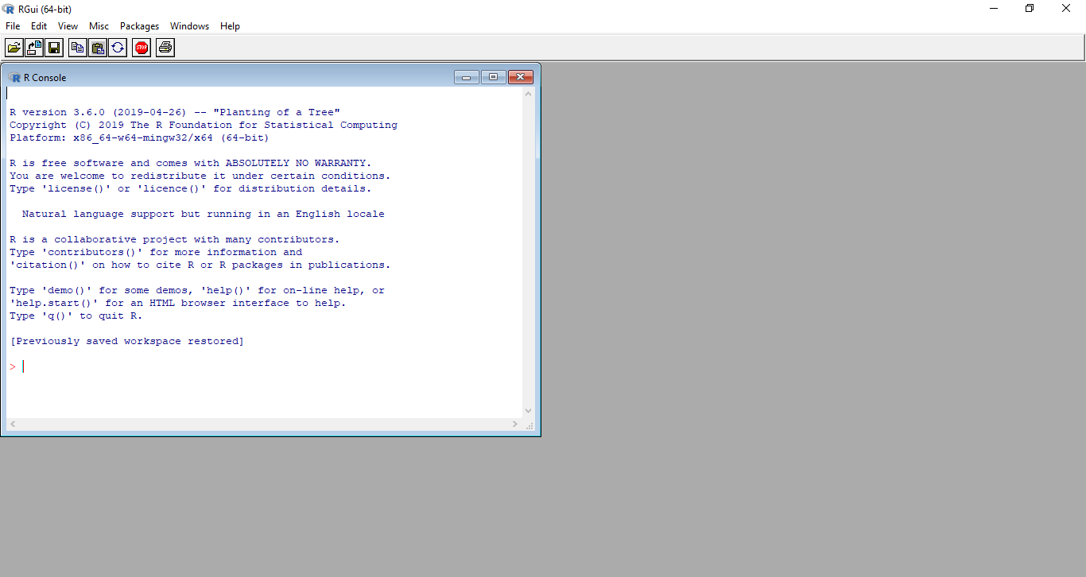
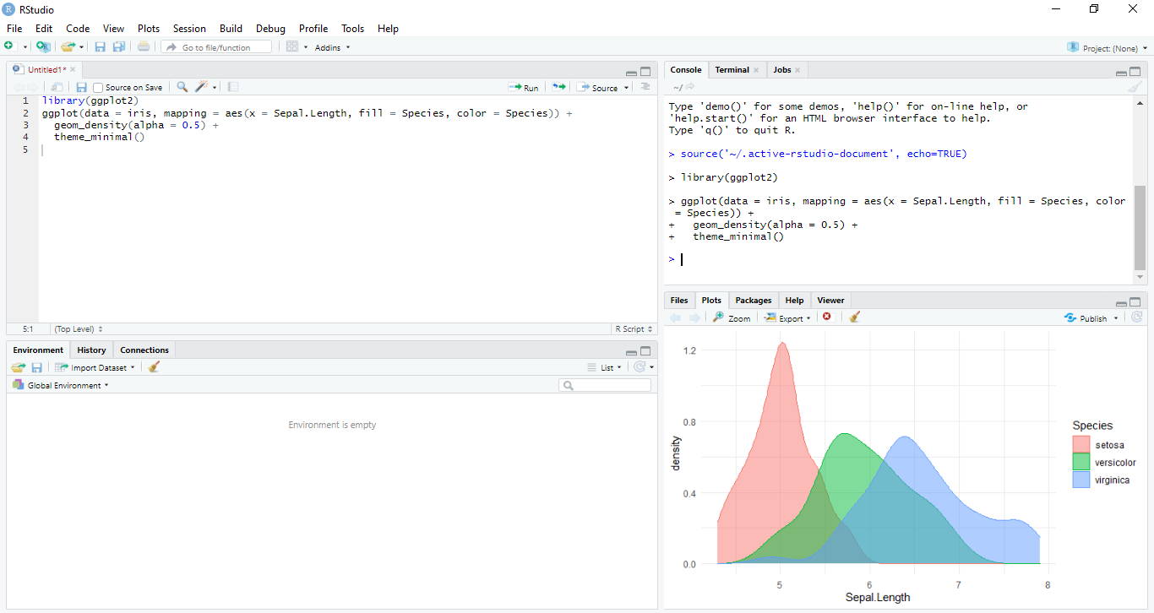
R dan RStudio
R GUI
Rstudio IDE

Slide 7
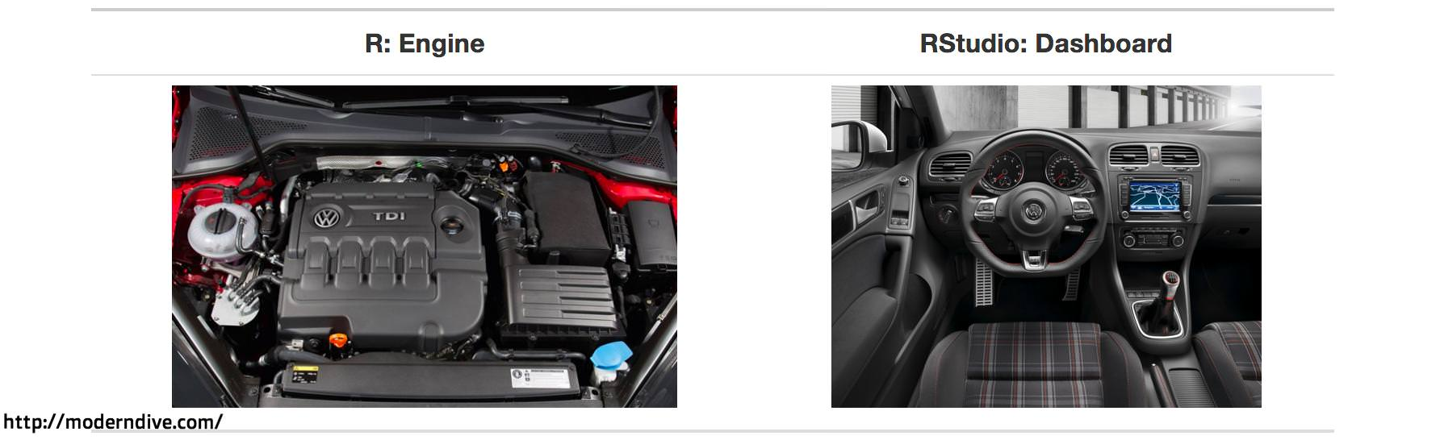
R dan RStudio

Slide 8
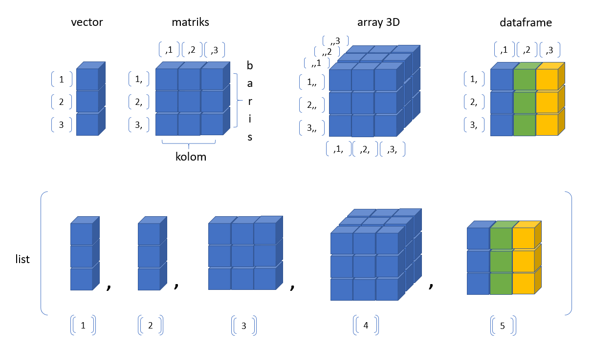
Objek Data di R

Slide 9
















R, File dan DBMS

Slide 10



dplyr, ggplot2 dan pipe
Powerful data management
Data processing and transformation in R became so easy
Awesome Visualization
Great package for visualization in R
Pipeline in R
It’s the And Then

Slide 11





More in R
Turn R code into REST API
Build Interactive Web App
Interface to Python
Web Scraping
Documentation

Slide 12
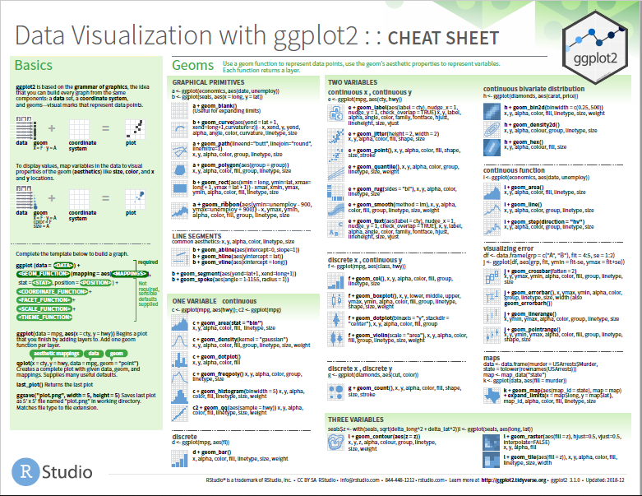
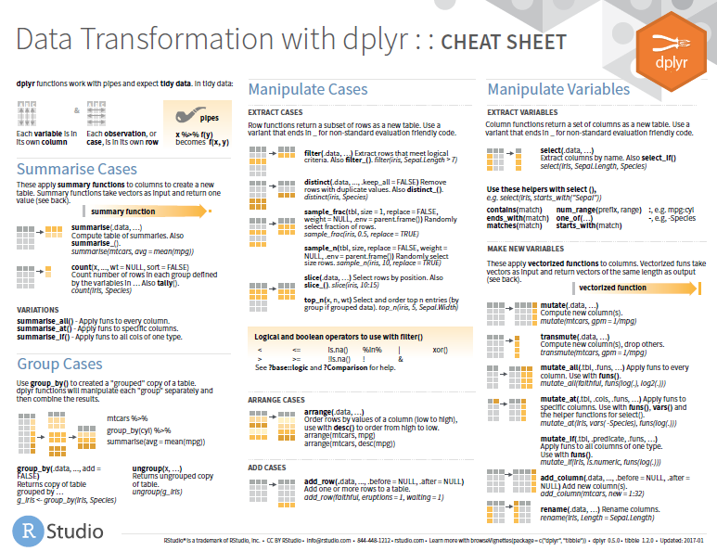
Cheat Sheets
https://www.rstudio.com/resources/cheatsheets/

Slide 13


Studi Kasus
Data yang digunakan diambil dan diolah dari
https://www.worldometers.info/coronavirus
https://www.worldometers.info/world-population/
https://bnpb-inacovid19.hub.arcgis.com/ (API)
Sumber gambar: https://covid19.kemenkes.go.id/
data/world_covid.csv
data/dailynational.csv

Slide 14
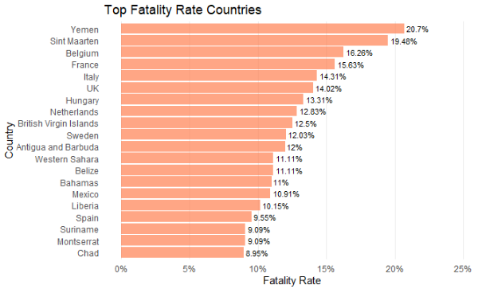
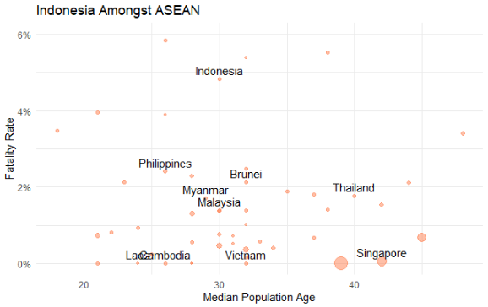
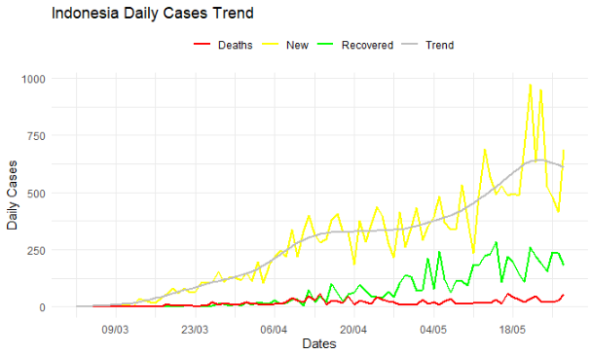
Visualisasi COVID19

Slide 15
{Visualisasi #1}

Slide 16
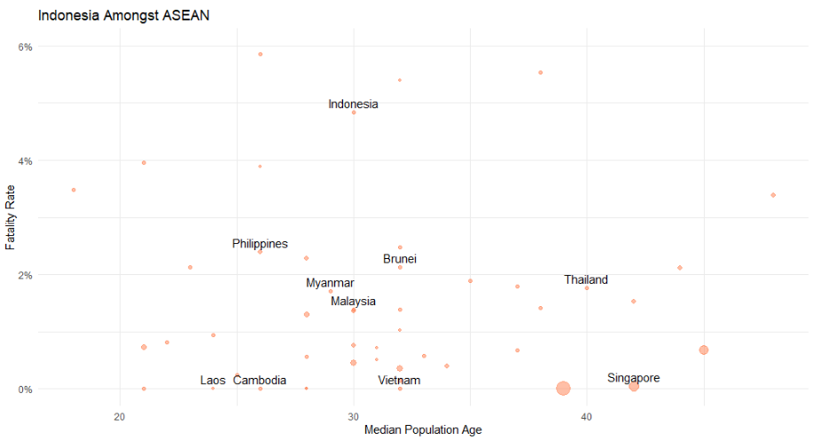
{Visualisasi #2}

Slide 17
{Visualisasi #3}

Slide 18
Lets {Code}!
https://rpubs.com/aephidayatuloh/kemenkes-coviz/

Slide 19
??? {Q & A}

Slide 20
ThankQ

